Slide 1


Click to new slide
SAMPLE BRAND GUIDELINES
New

Slide 2

Old
New

Slide 3



Humanity & Community
It reflects the spirit of giving, collaboration, and shared responsibility. The choice of a human hand underscores our commitment to making a tangible, positive impact within the communities we serve, embodying the essence of empathy and collective well-being
Icon
Yellow & Blue
Incorporating the vibrant yellow and deep blue hues into our logo design signifies optimism, warmth, and stability. Yellow represents the radiant energy and hope we bring to our initiatives, while dark blue conveys trust, reliability, and the steadfast nature of our commitment. Together, these colors create a visually compelling identity that mirrors our organization's values, inspiring a sense of confidence and compassion within our community-focused endeavors.
Yellow & Blue Color

Slide 4


Slide 5





Slide 6





Slide 7




Slide 8
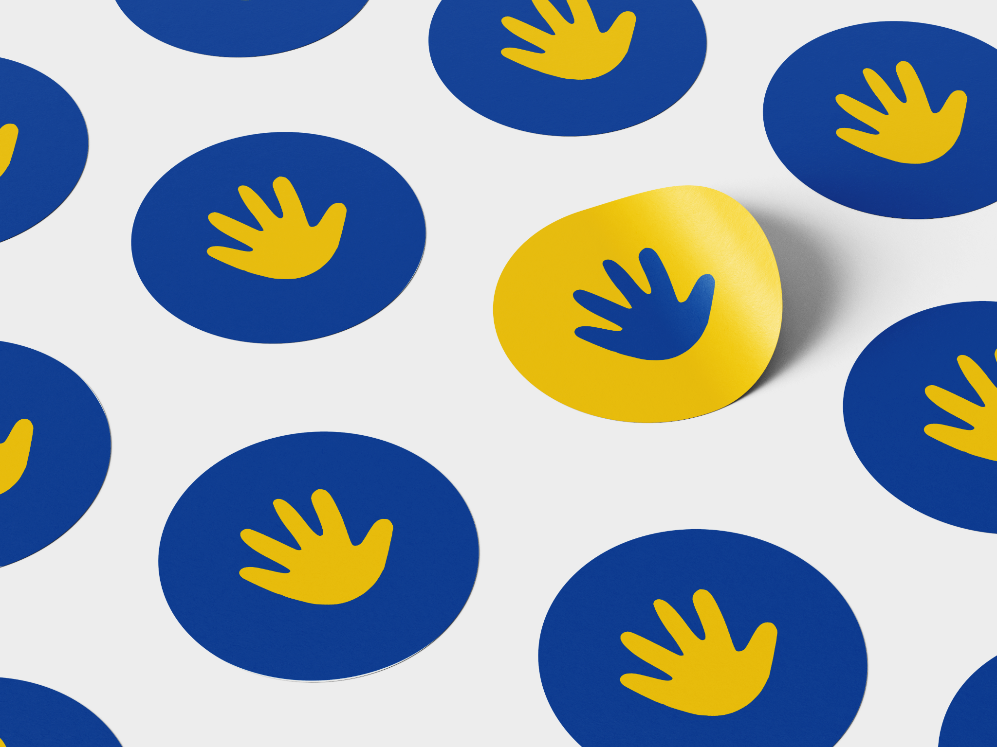

Slide 9
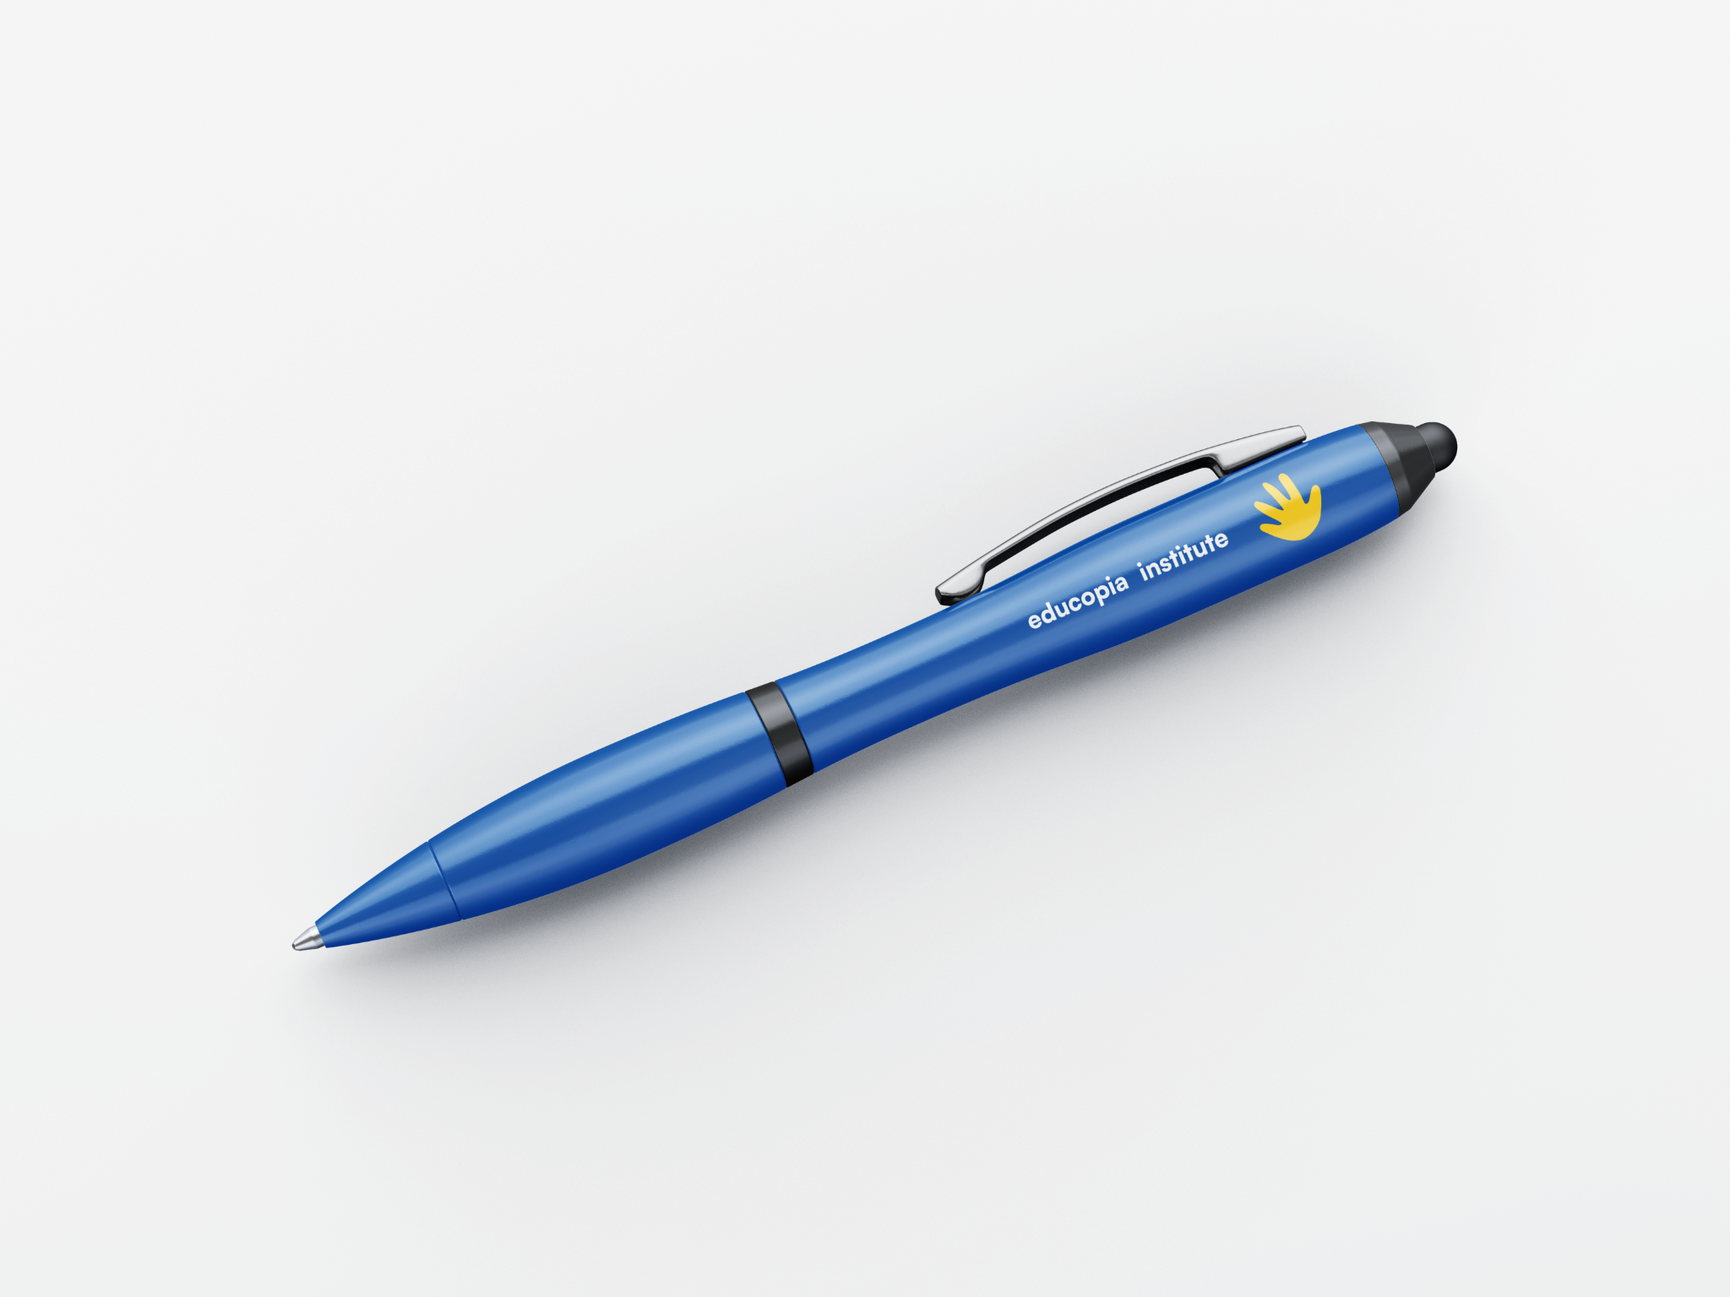

Slide 10

Please play the video

